Slide 1
Introduction to GIS and ArcGIS
How a GIS works
Introduction to ArcGIS

Slide 2
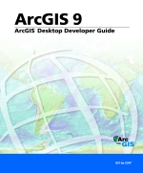
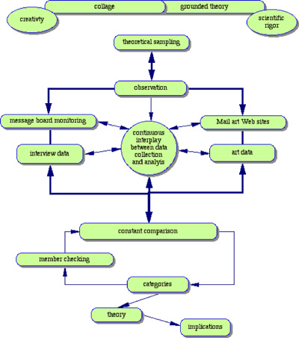
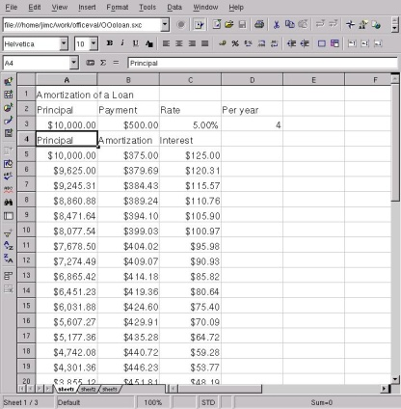
A GIS integrates five basic components
software
methods
hardware
data
people

Slide 3
Data

Slide 4
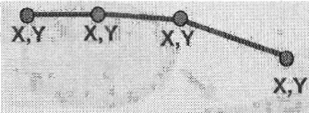
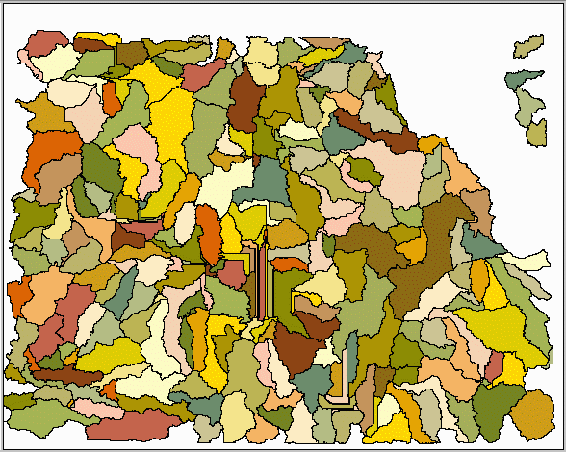
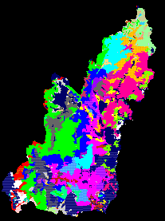
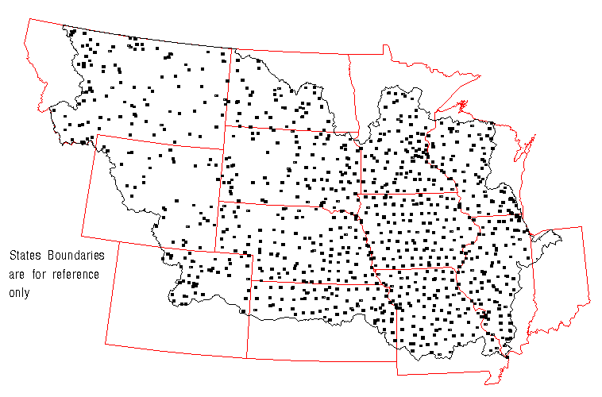
Types of datasets
Vector formats
(“feature classes”)
Points
Lines (”arcs”)
Polygons

Slide 5
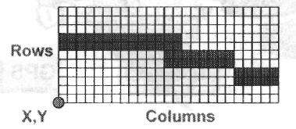
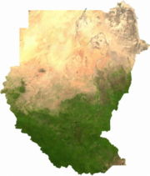
Types of datasets
Raster formats
Matrices of square cells (grids, pixels)

Slide 6
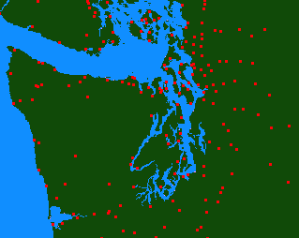
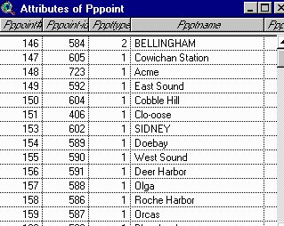
Types of datasets
Attribute tables:
tables of data describing spatial features

Slide 7
GIS Data Types
Spatial data:
describes the absolute and relative location of geographic features.
Attribute data:
describes characteristics of the spatial features.
quantitative and/or qualitative
attribute data is often referred to as tabular data.

Slide 8
Spatial data: Vector vs Raster

Slide 9
Methods

Slide 10
Basic GIS Functions
Capture
Store
Query
Analyze
Display
Output

Slide 11
Capturing data
Digital images
Paper maps
GIS
GPS output
Coordinate lists

Slide 12
Query
Identifying specific features
Where is parcel No. 2945?
Identifying features based on conditions
Find all trees with DBH > 35 cm

Slide 13
Display
Maps
Graphs
Reports/Tables

